Slide 1
Forecasting Walmart store sales with Time Series Analysis (SAS Studio)

Slide 2
01
Business Goal
Forecasting future store sales by conducting time series analysis on historical weekly sales

Slide 3
02
Dependent Variable
Weekly Sales $ for 1 randomly selected Walmart Store

Slide 4
03
Dataset - Walmart Data

Slide 5
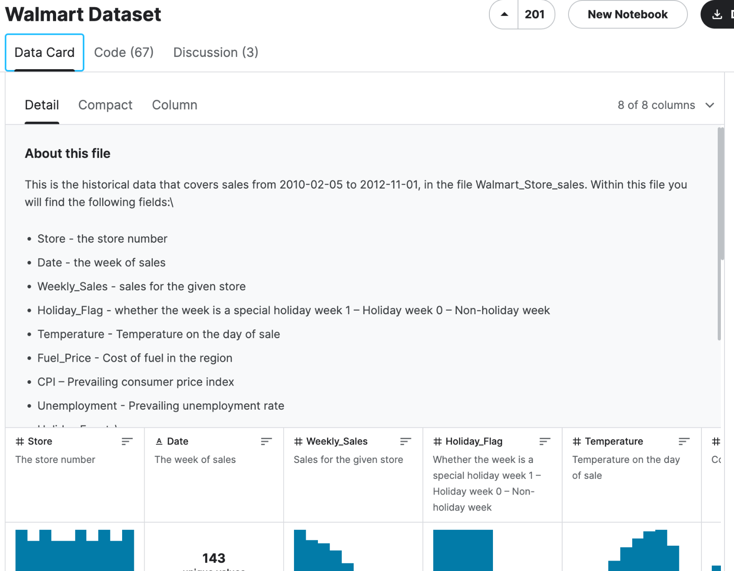
Dataset - Kaggle
https://www.kaggle.com/datasets/yasserh/walmart-dataset/data
Our complete dataset contains weekly sales for 45 Walmart stores for the year of 2010 to 2012.
We chose to only focus on Store 1 for our time series analysis.

Slide 6
04
Control Chart - Excel

Slide 7
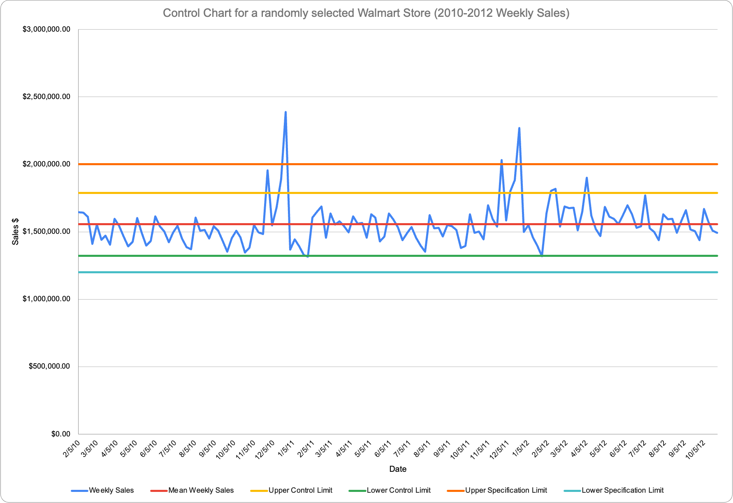
Control Chart in Excel
Our control chart breaks both the upper and lower control limits on multiple instances - by which could be the cause of holiday spending as seen by the huge spikes in December 2010 and December 2011.
Therefore, our control chart is out of control at several instances, when they break the upper limit and upper specification limit, and when they break below the lower limit. We note that the lower limit was broken only twice by a slim margin and therefore we conclude that there have not been instances where the store underperformed too poorly.

Slide 8
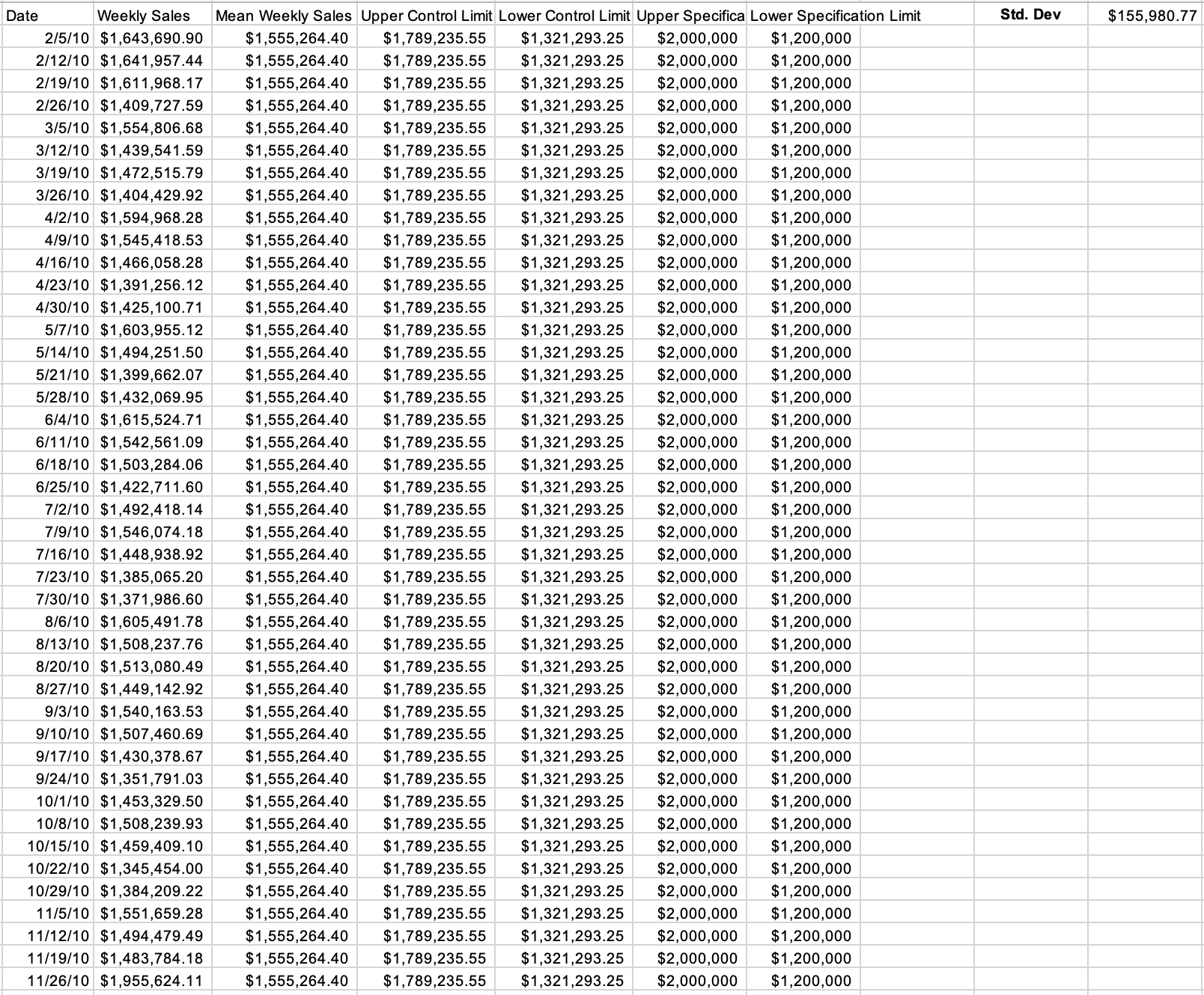
Control Chart in Excel
We calculated the control limits by adding the mean and multiplying 1.5 times the standard deviation.
We agreed to set the upper specification limit to $2,000,000 and lower specification limit to $1,200,000.
This is based on historical sales and business objective of both maximizing profit and minimizing losses. Given that the dataset contains spending behavior after an economic recession.

Slide 9
05
Control Chart - SAS STUDIO

Slide 10
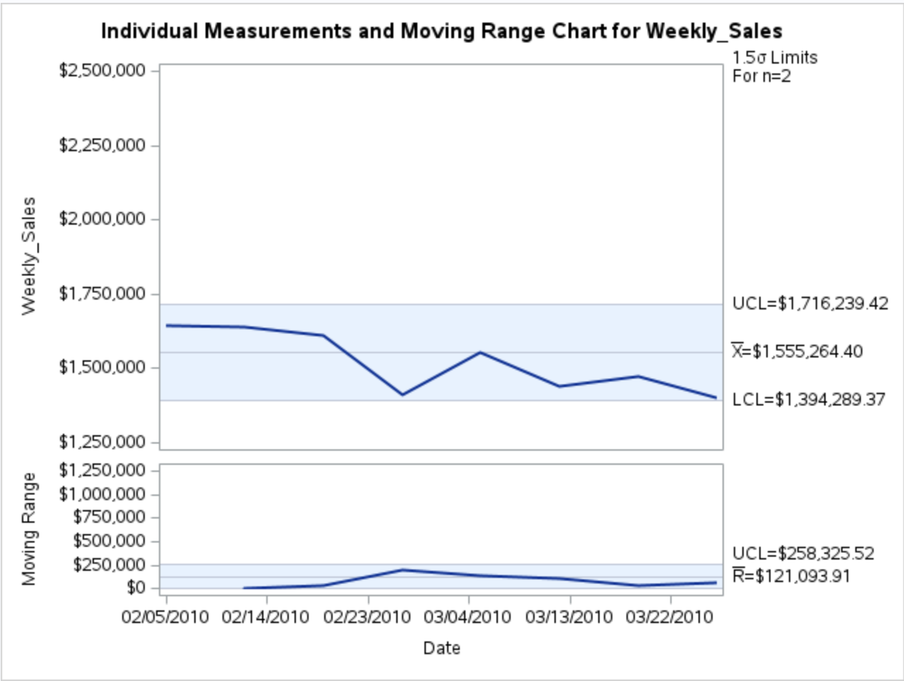
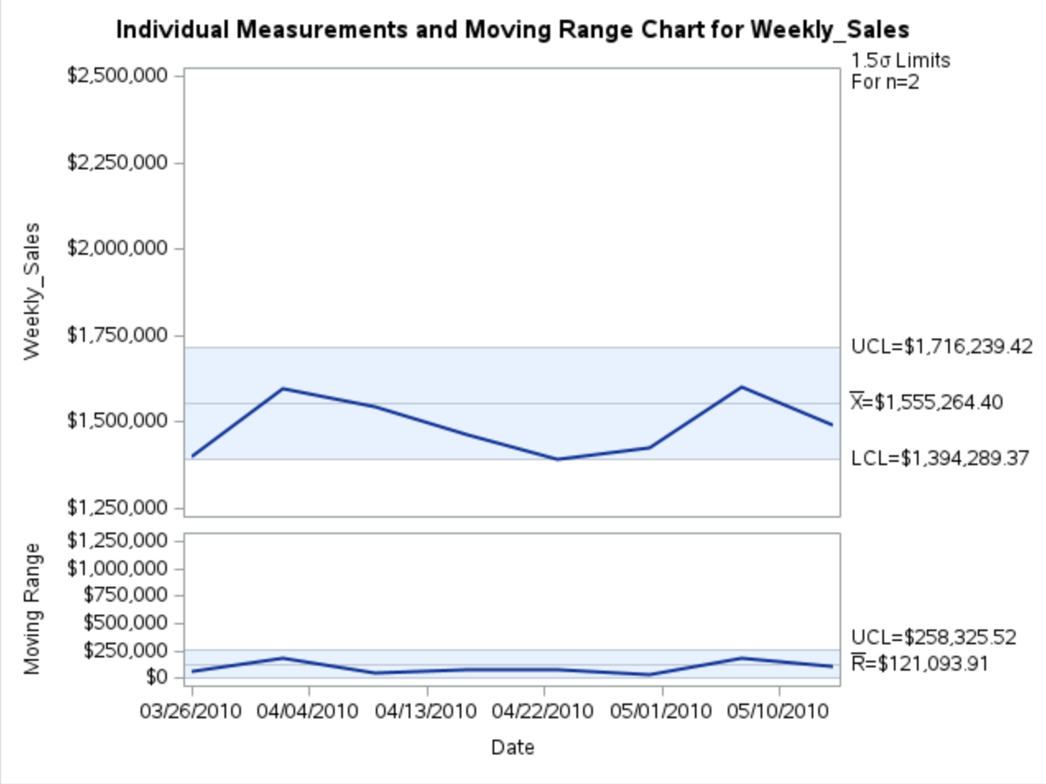
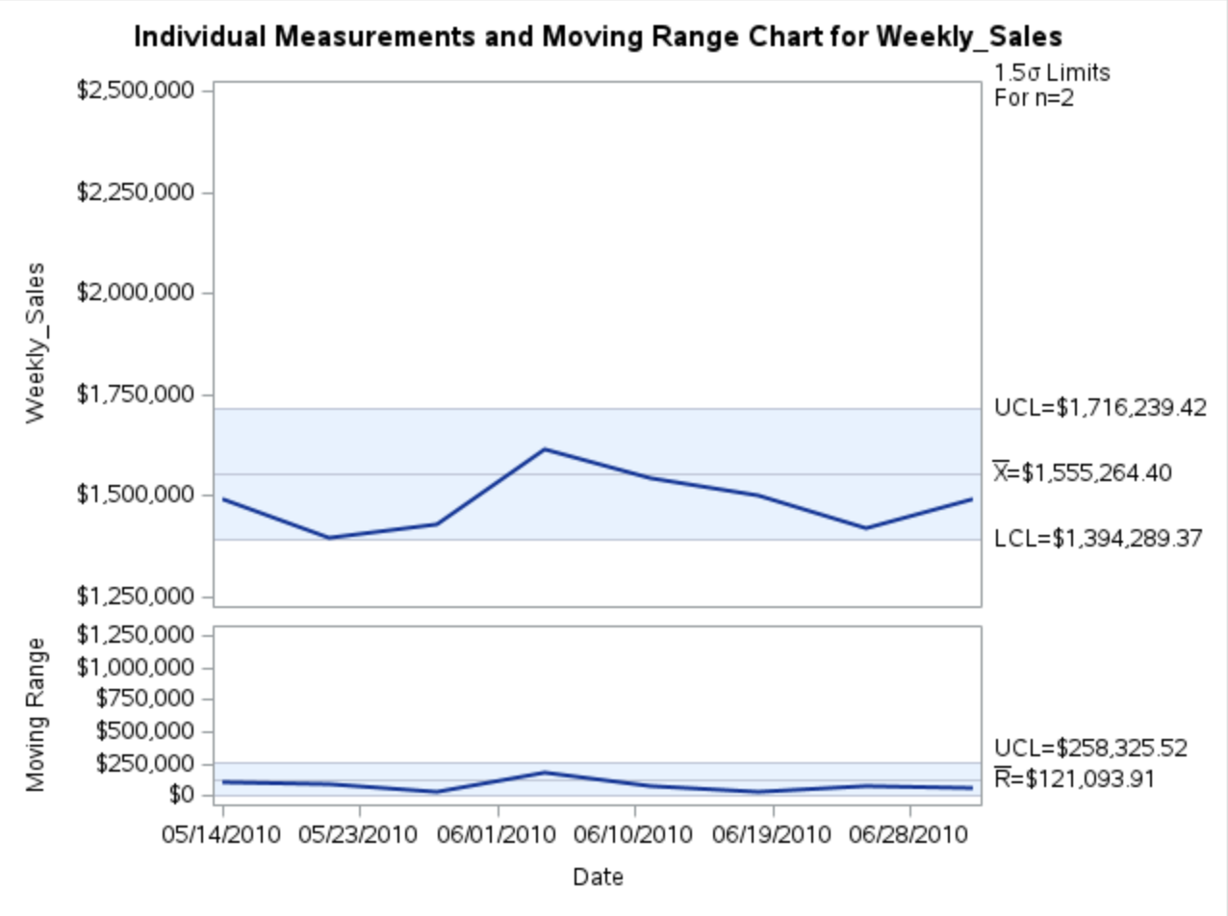
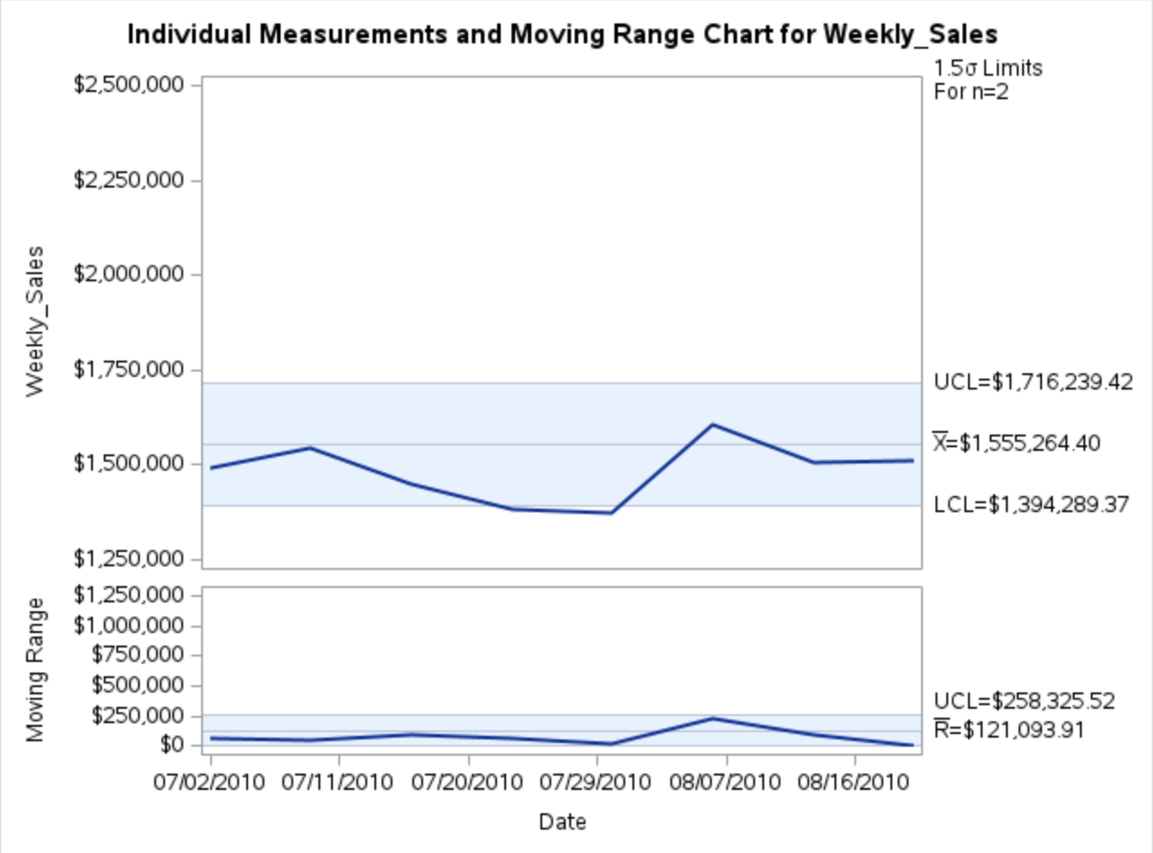
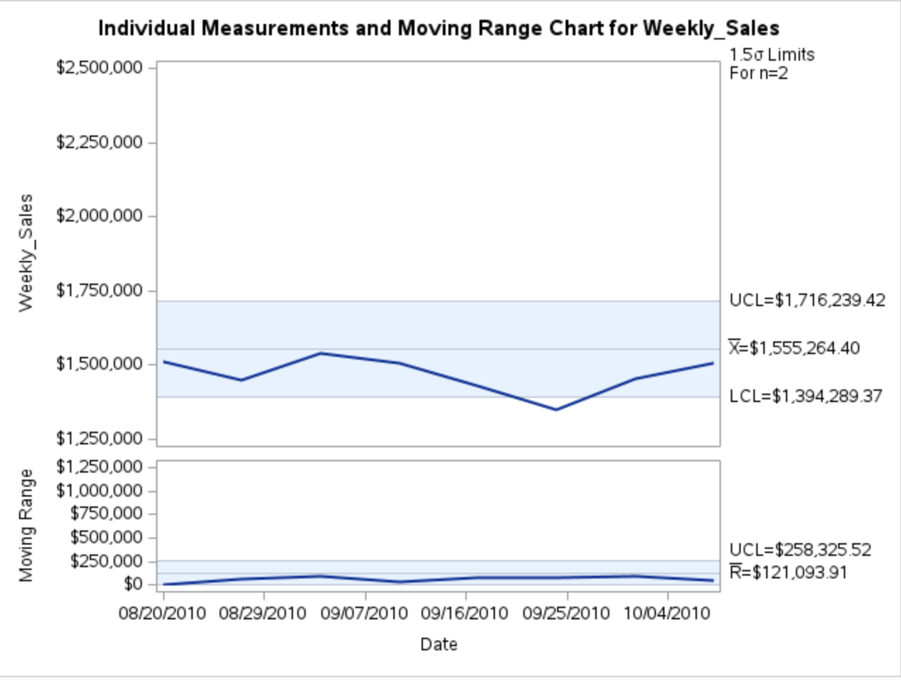
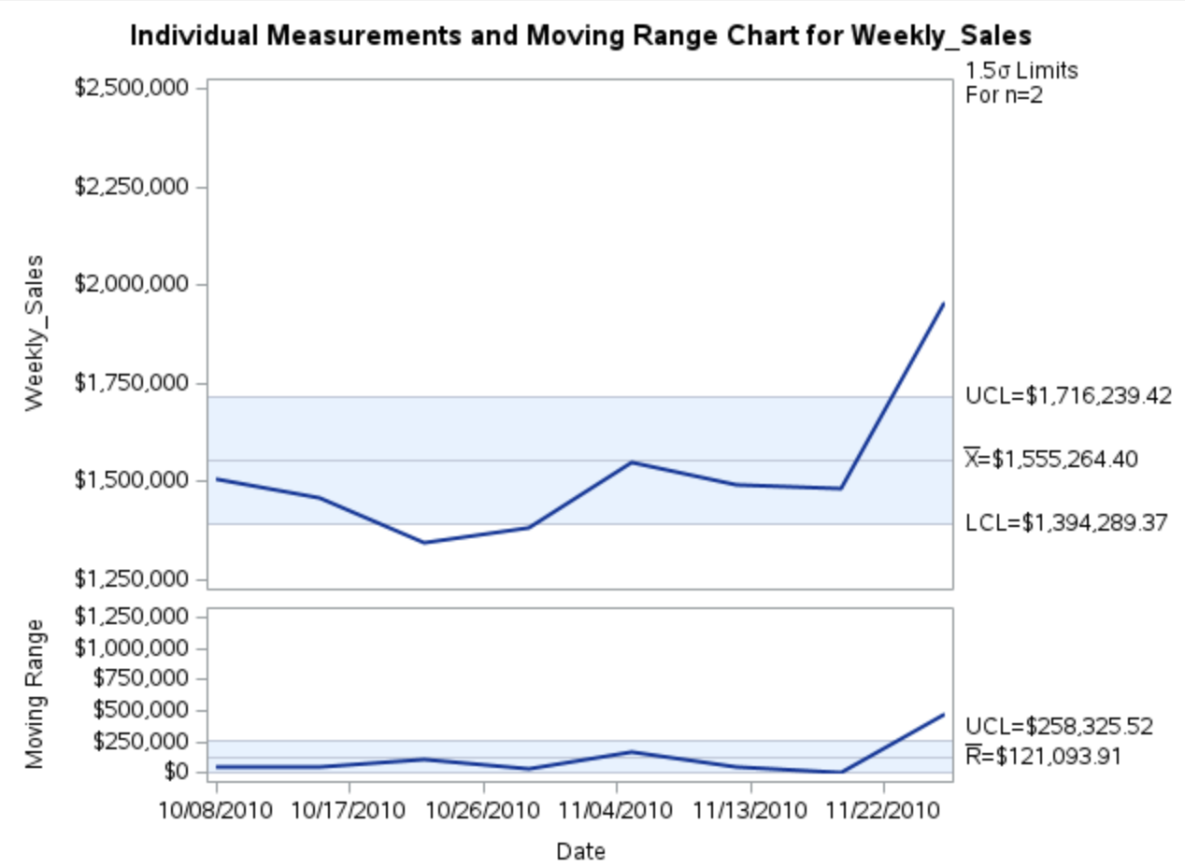
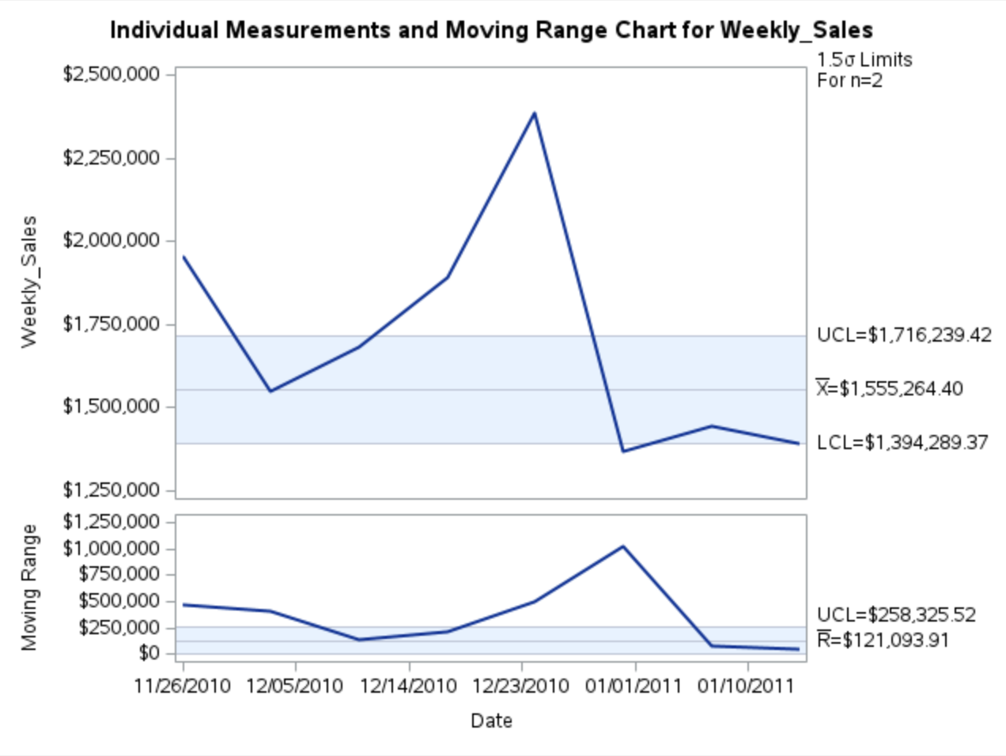
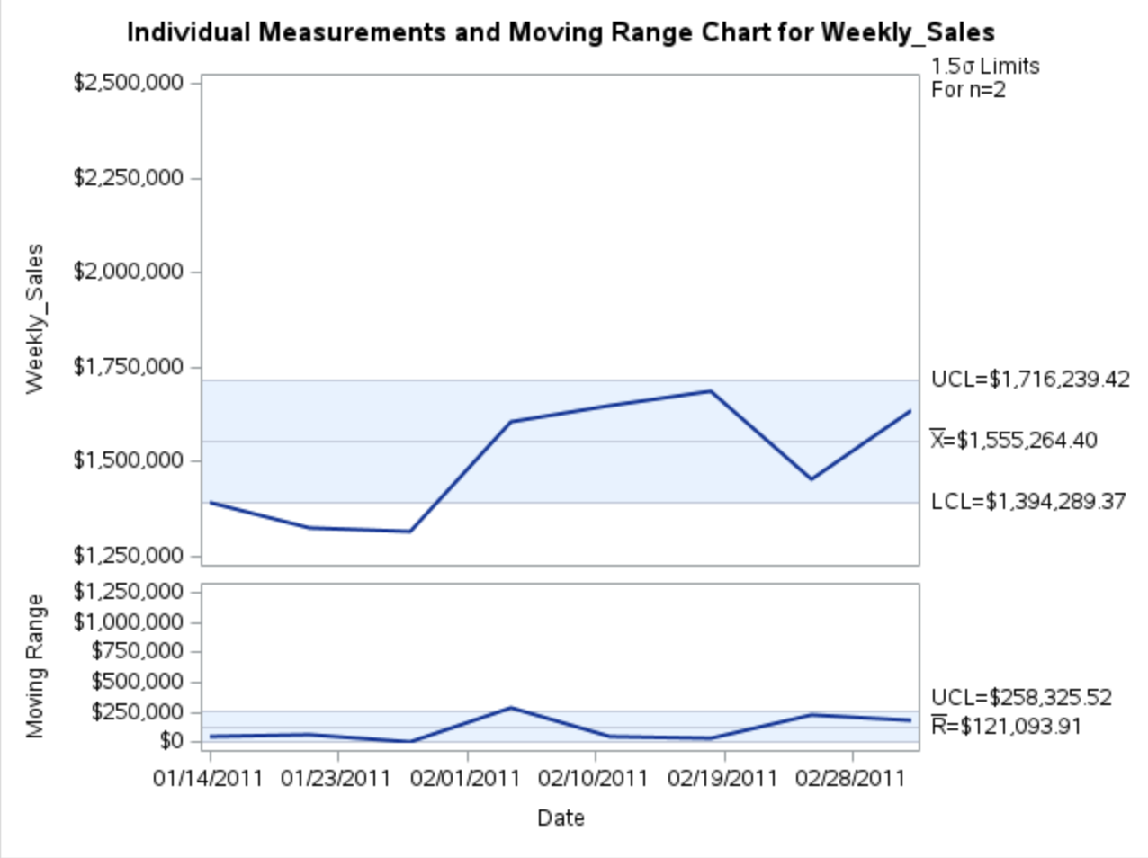
Control Chart in SAS
*The graphs represent control charts for weekly sales over the 3-year period, between 2010 and 2012

Slide 11
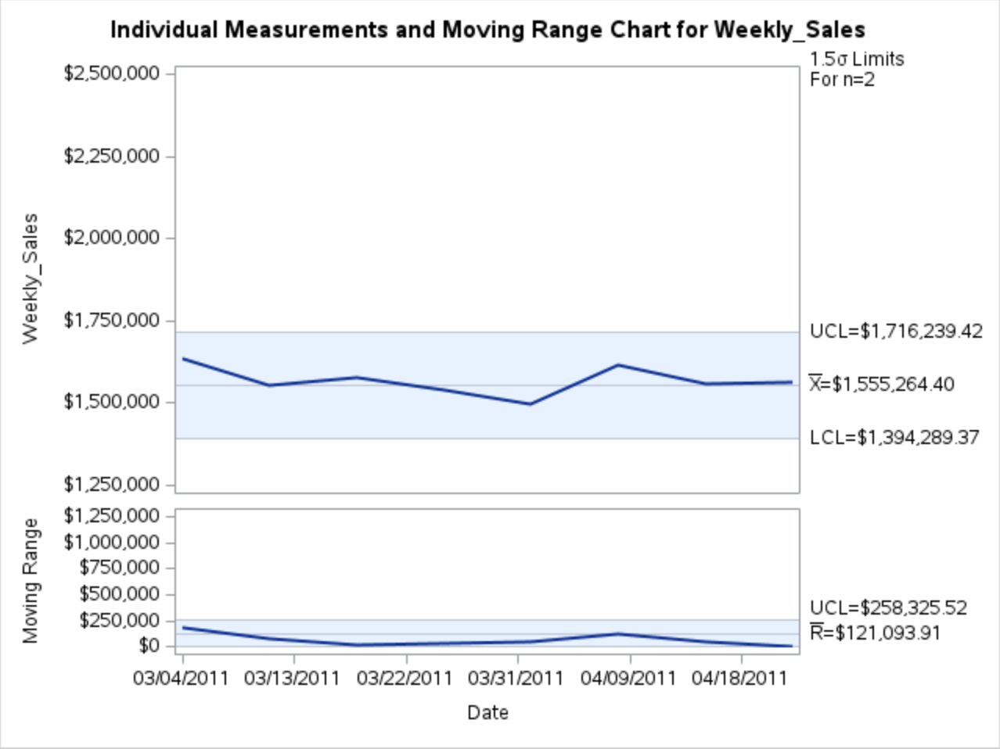
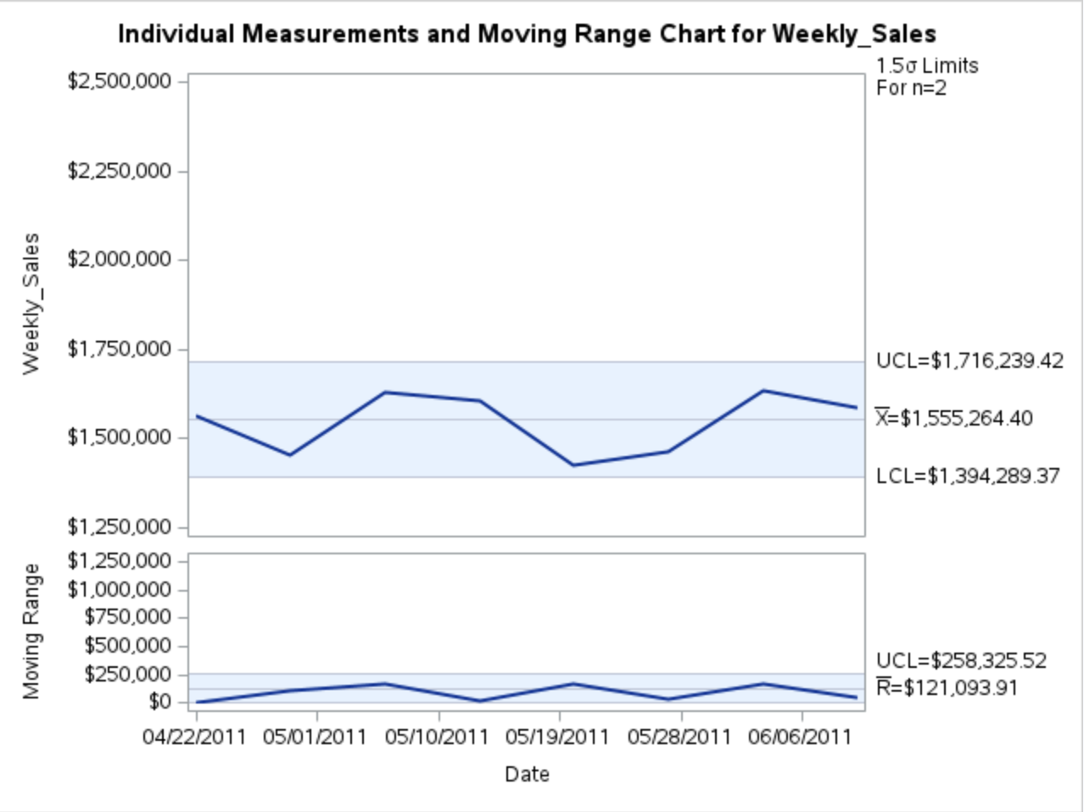
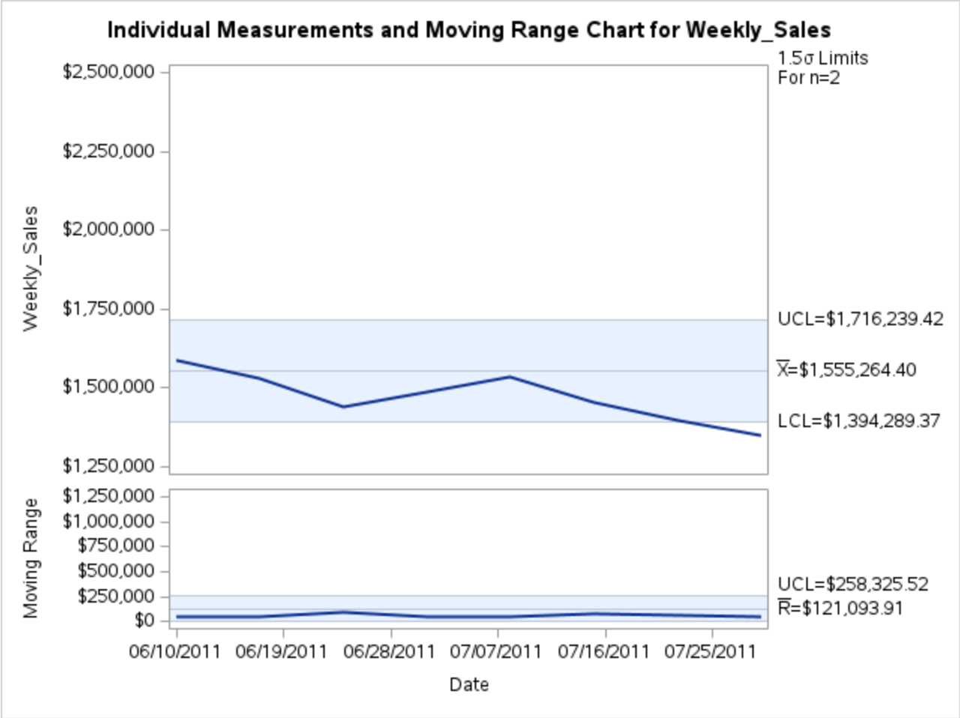
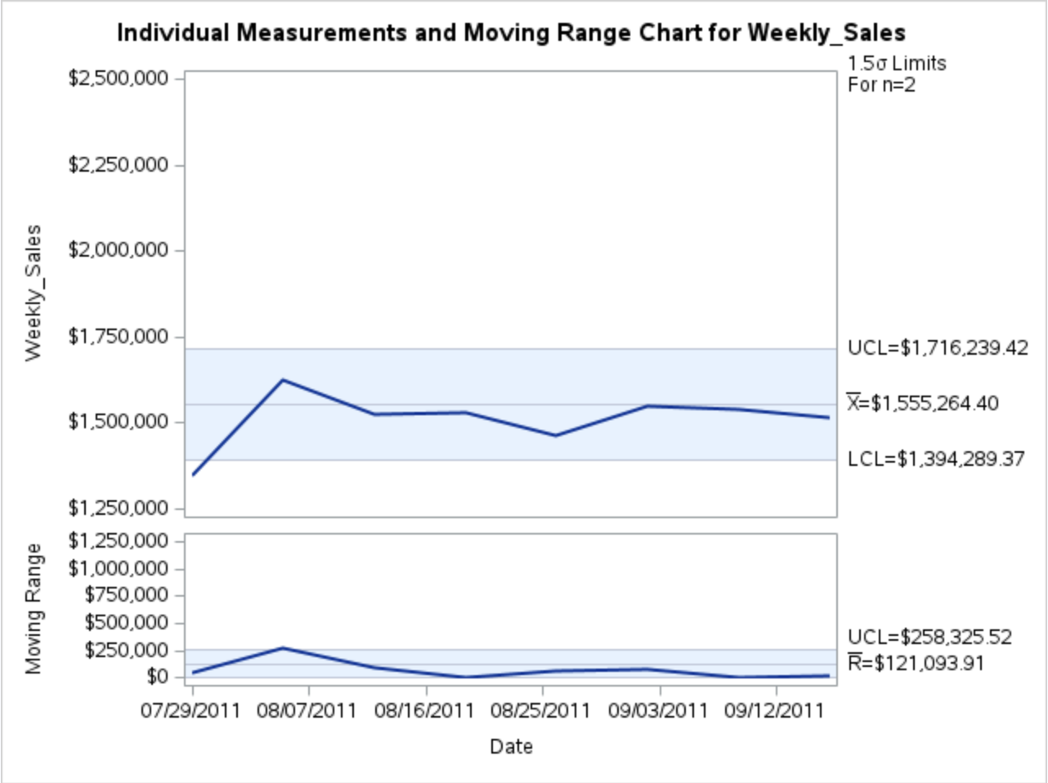
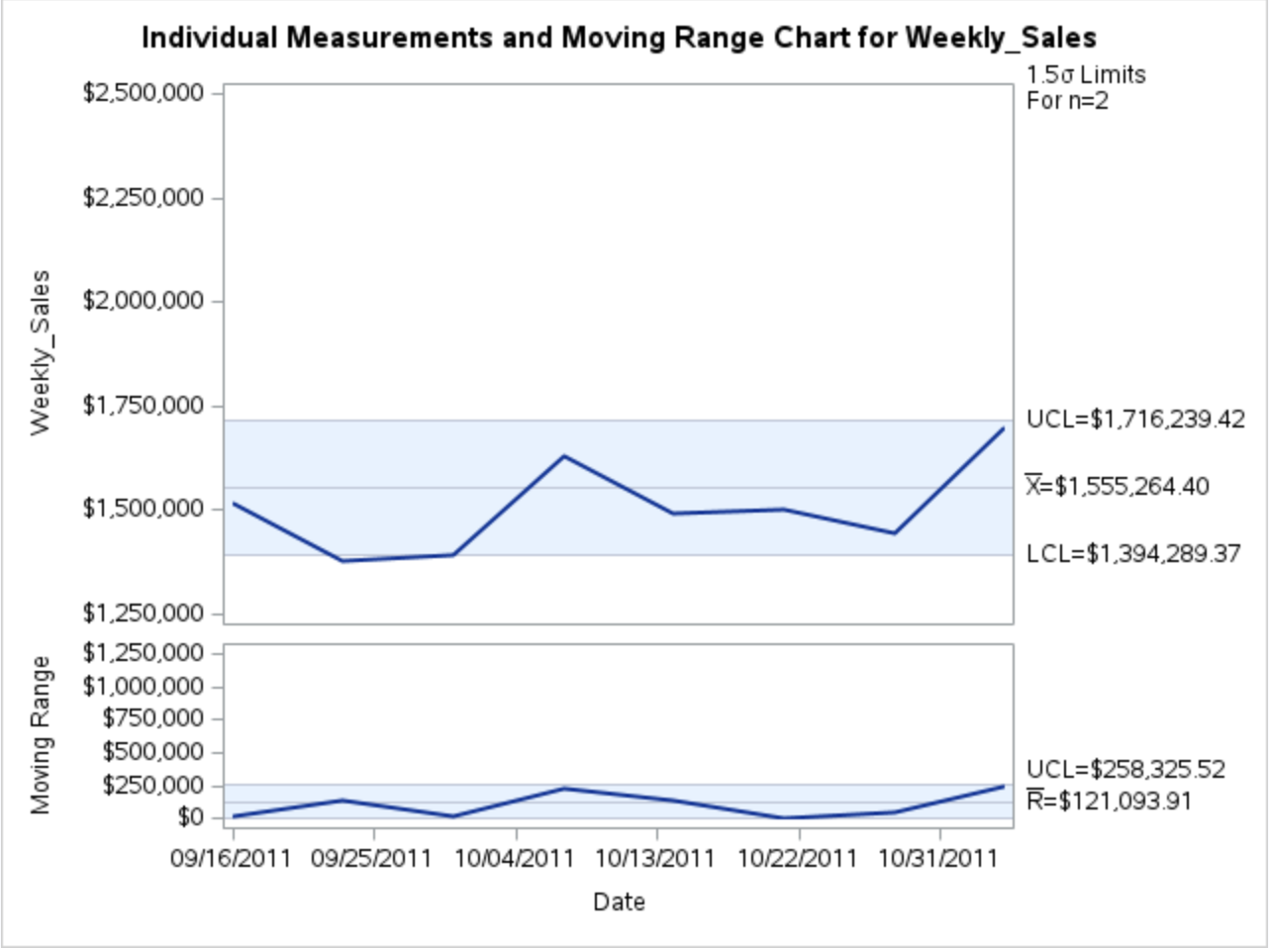
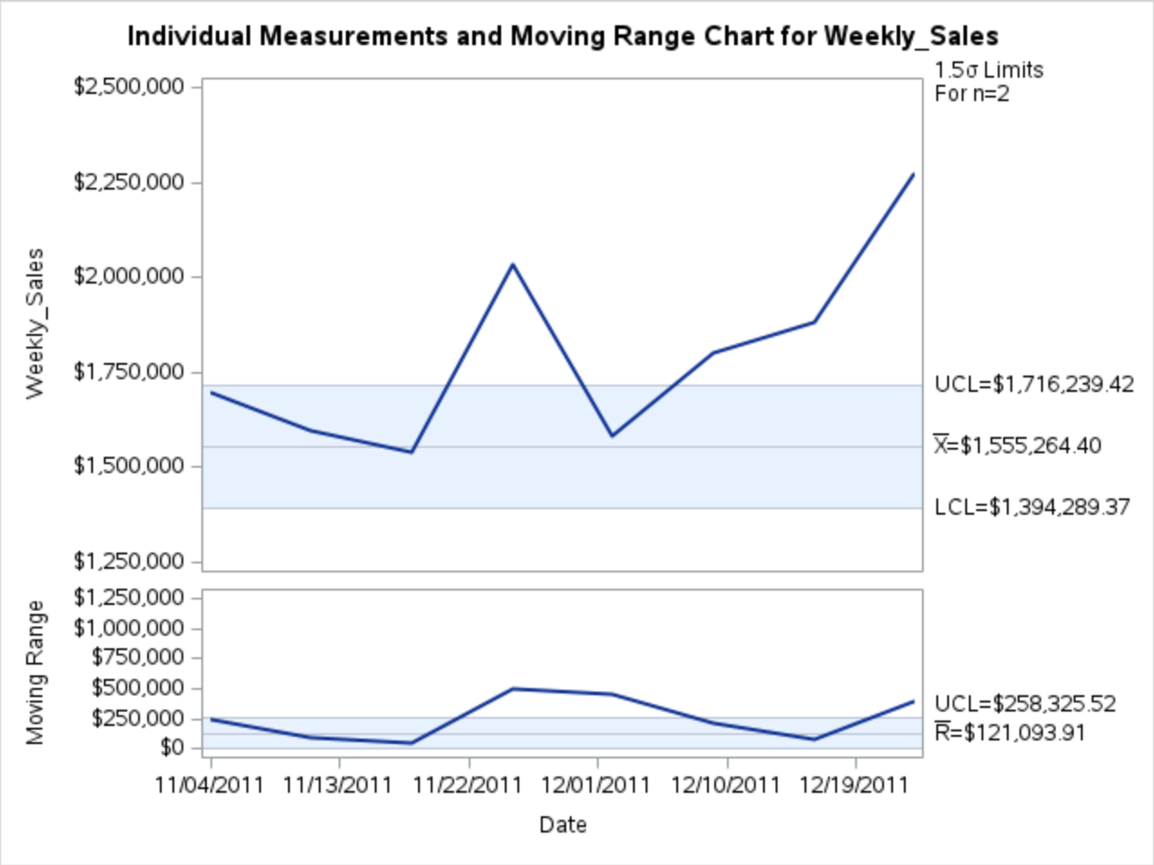
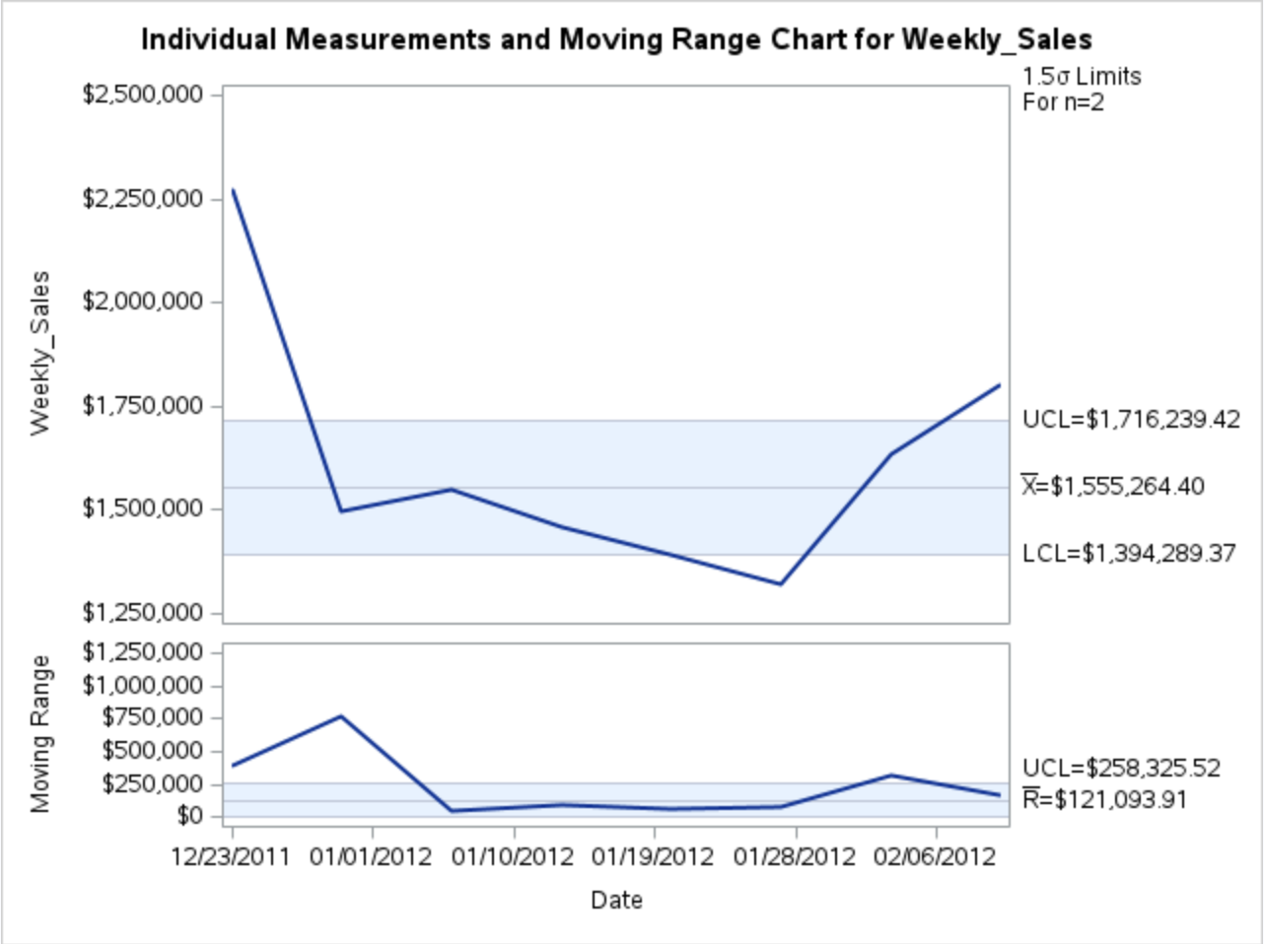
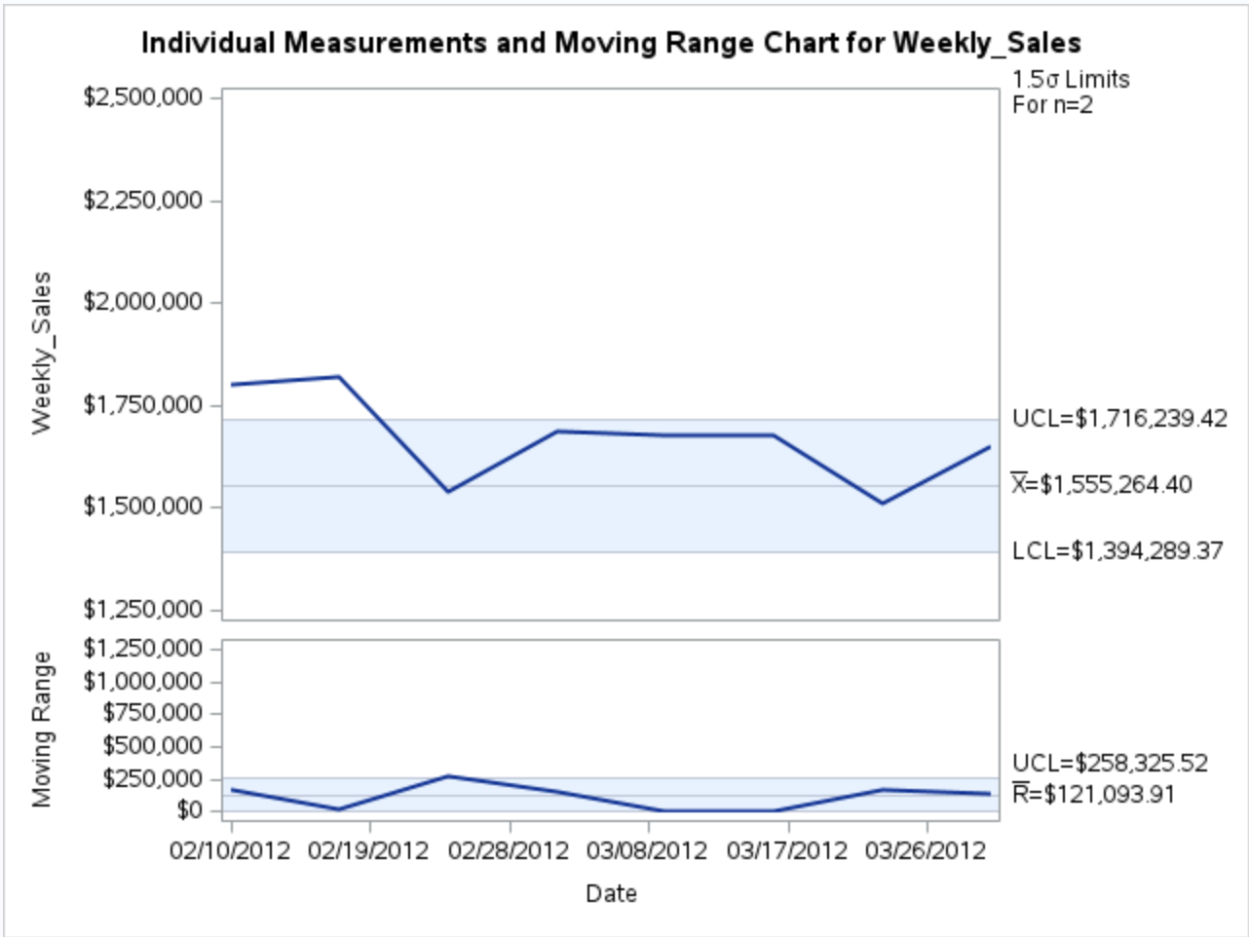
Control Chart in SAS
*The graphs represent control charts for weekly sales over the 3-year period, between 2010 and 2012

Slide 12
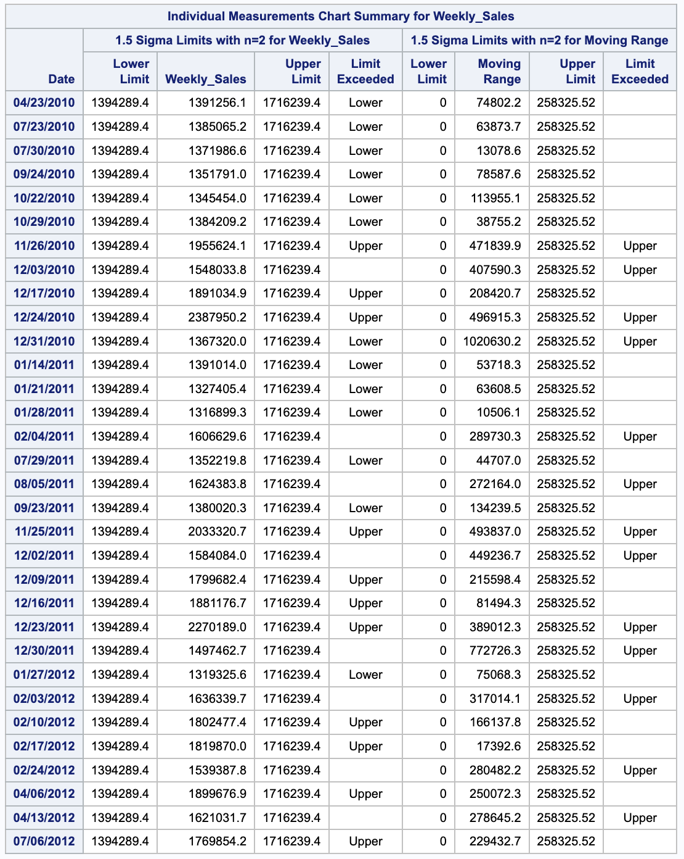
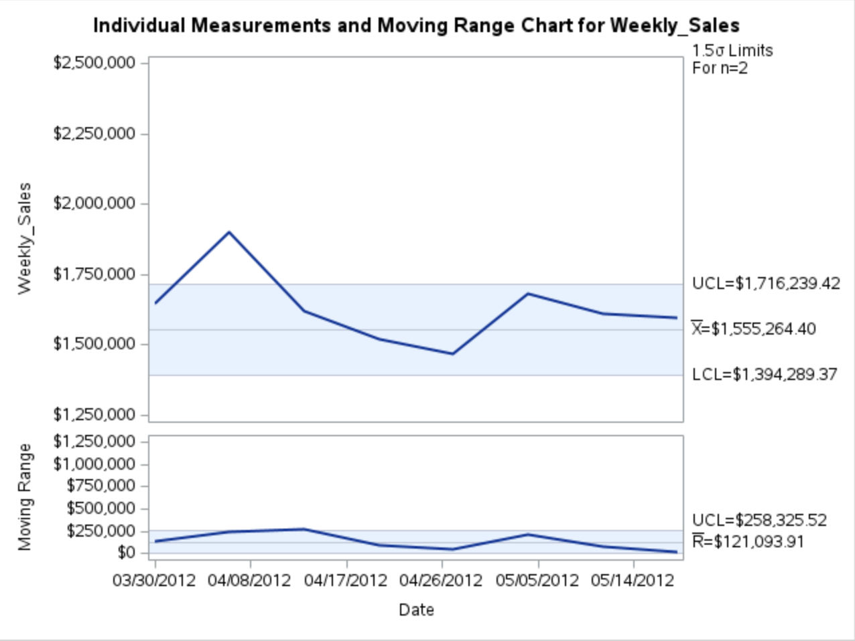
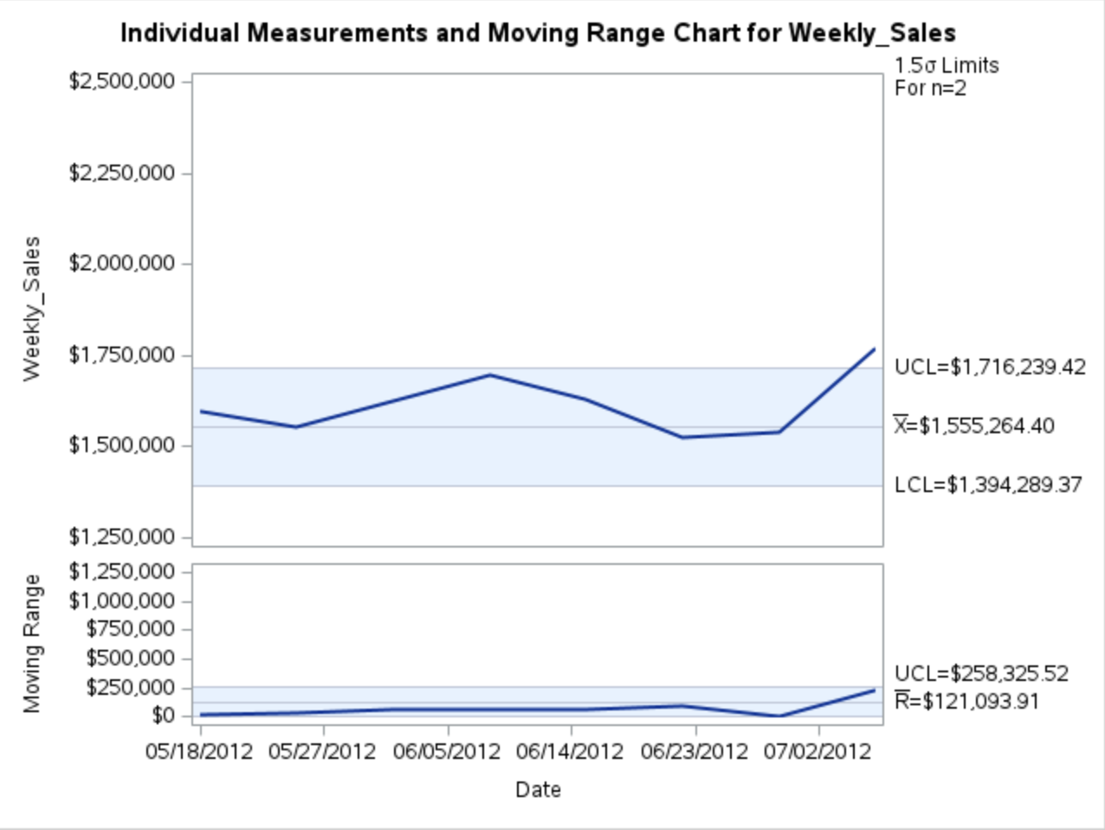
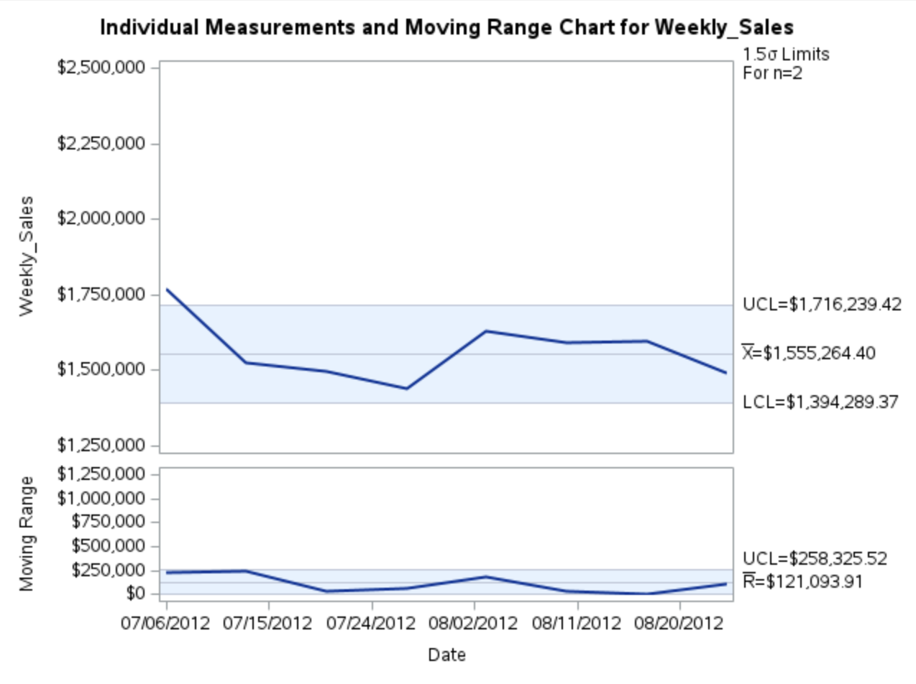
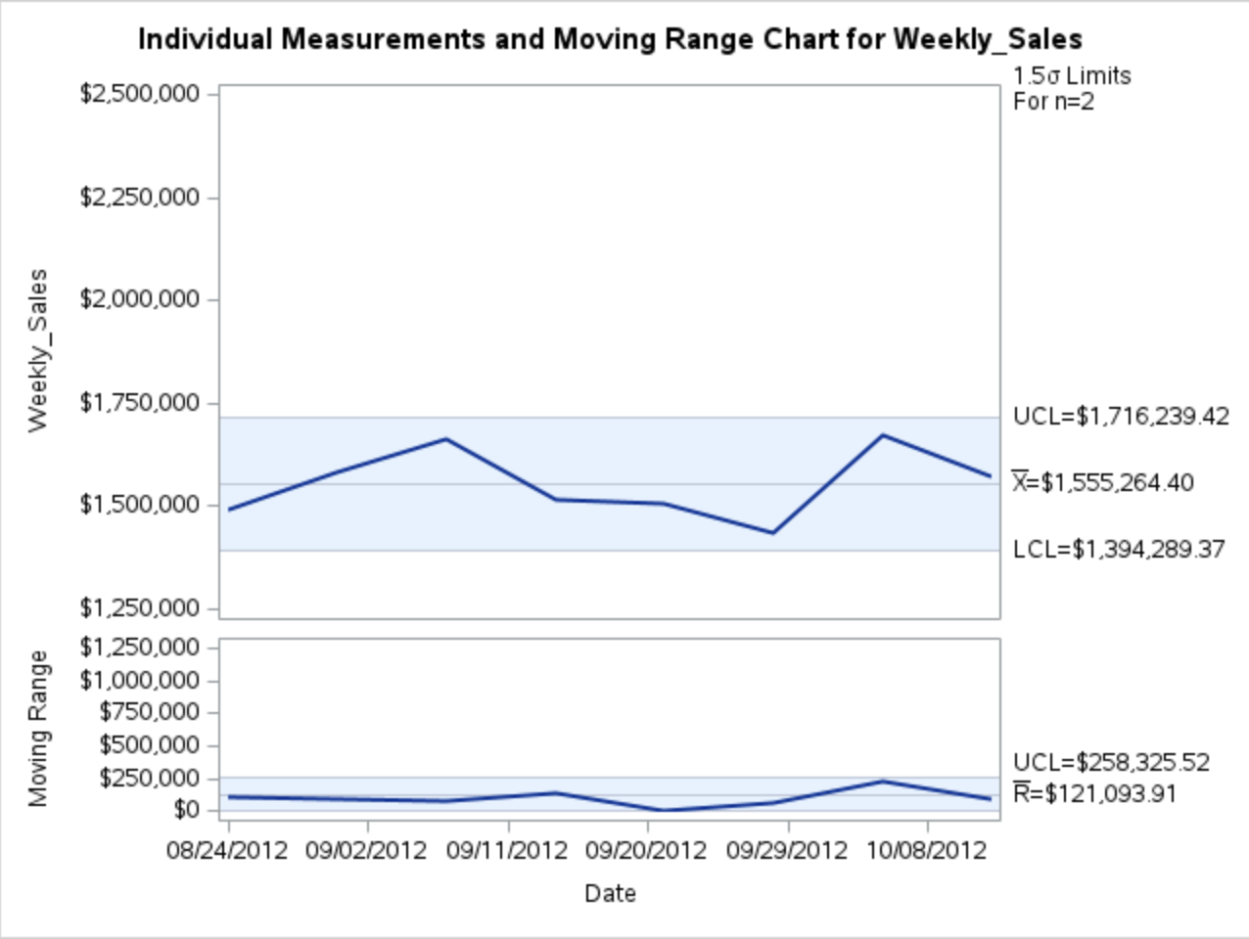
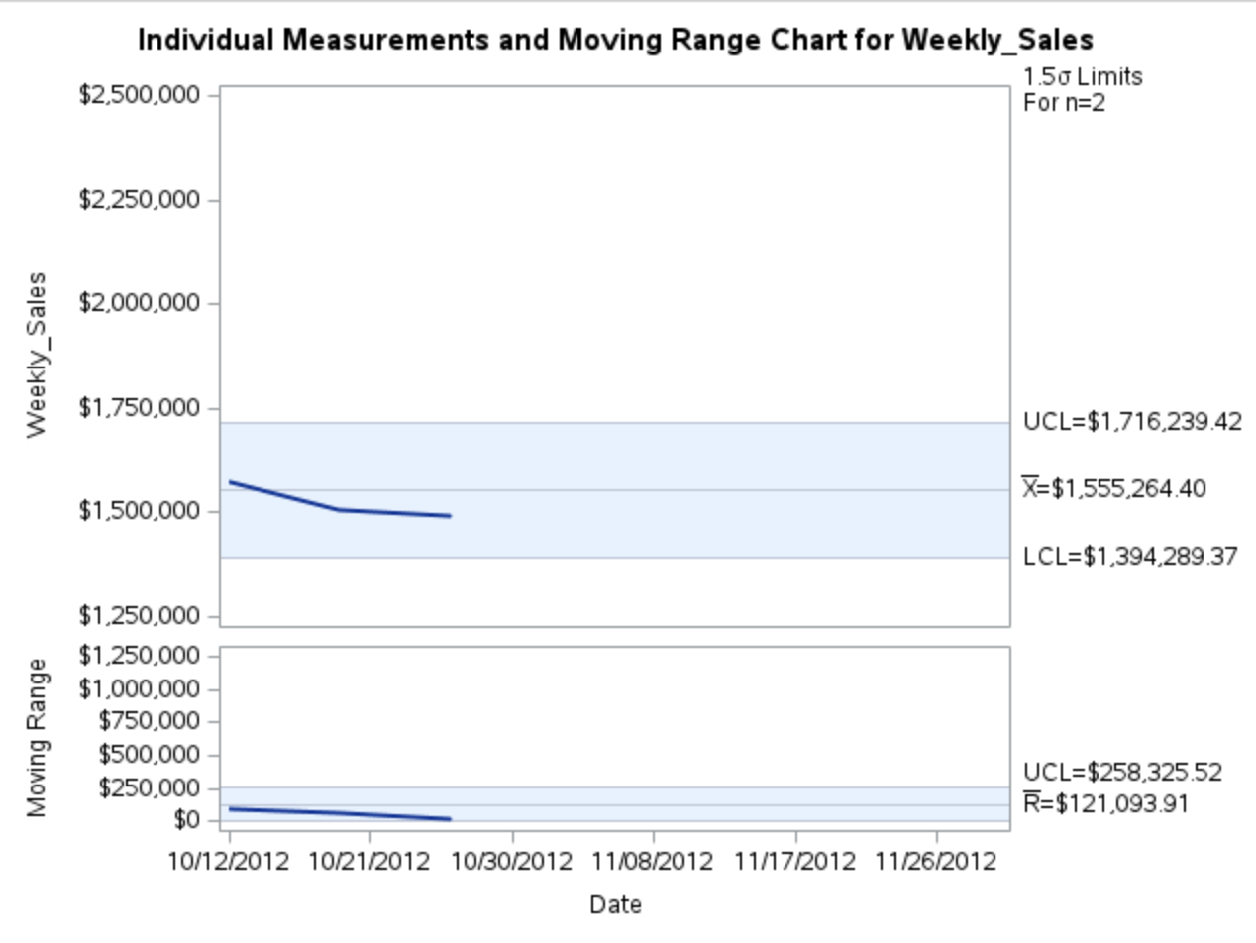
Control Chart in SAS
*The graphs represent control charts for weekly sales over the 3-year period, between 2010 and 2012

Slide 13
06
Tableau Results

Slide 14
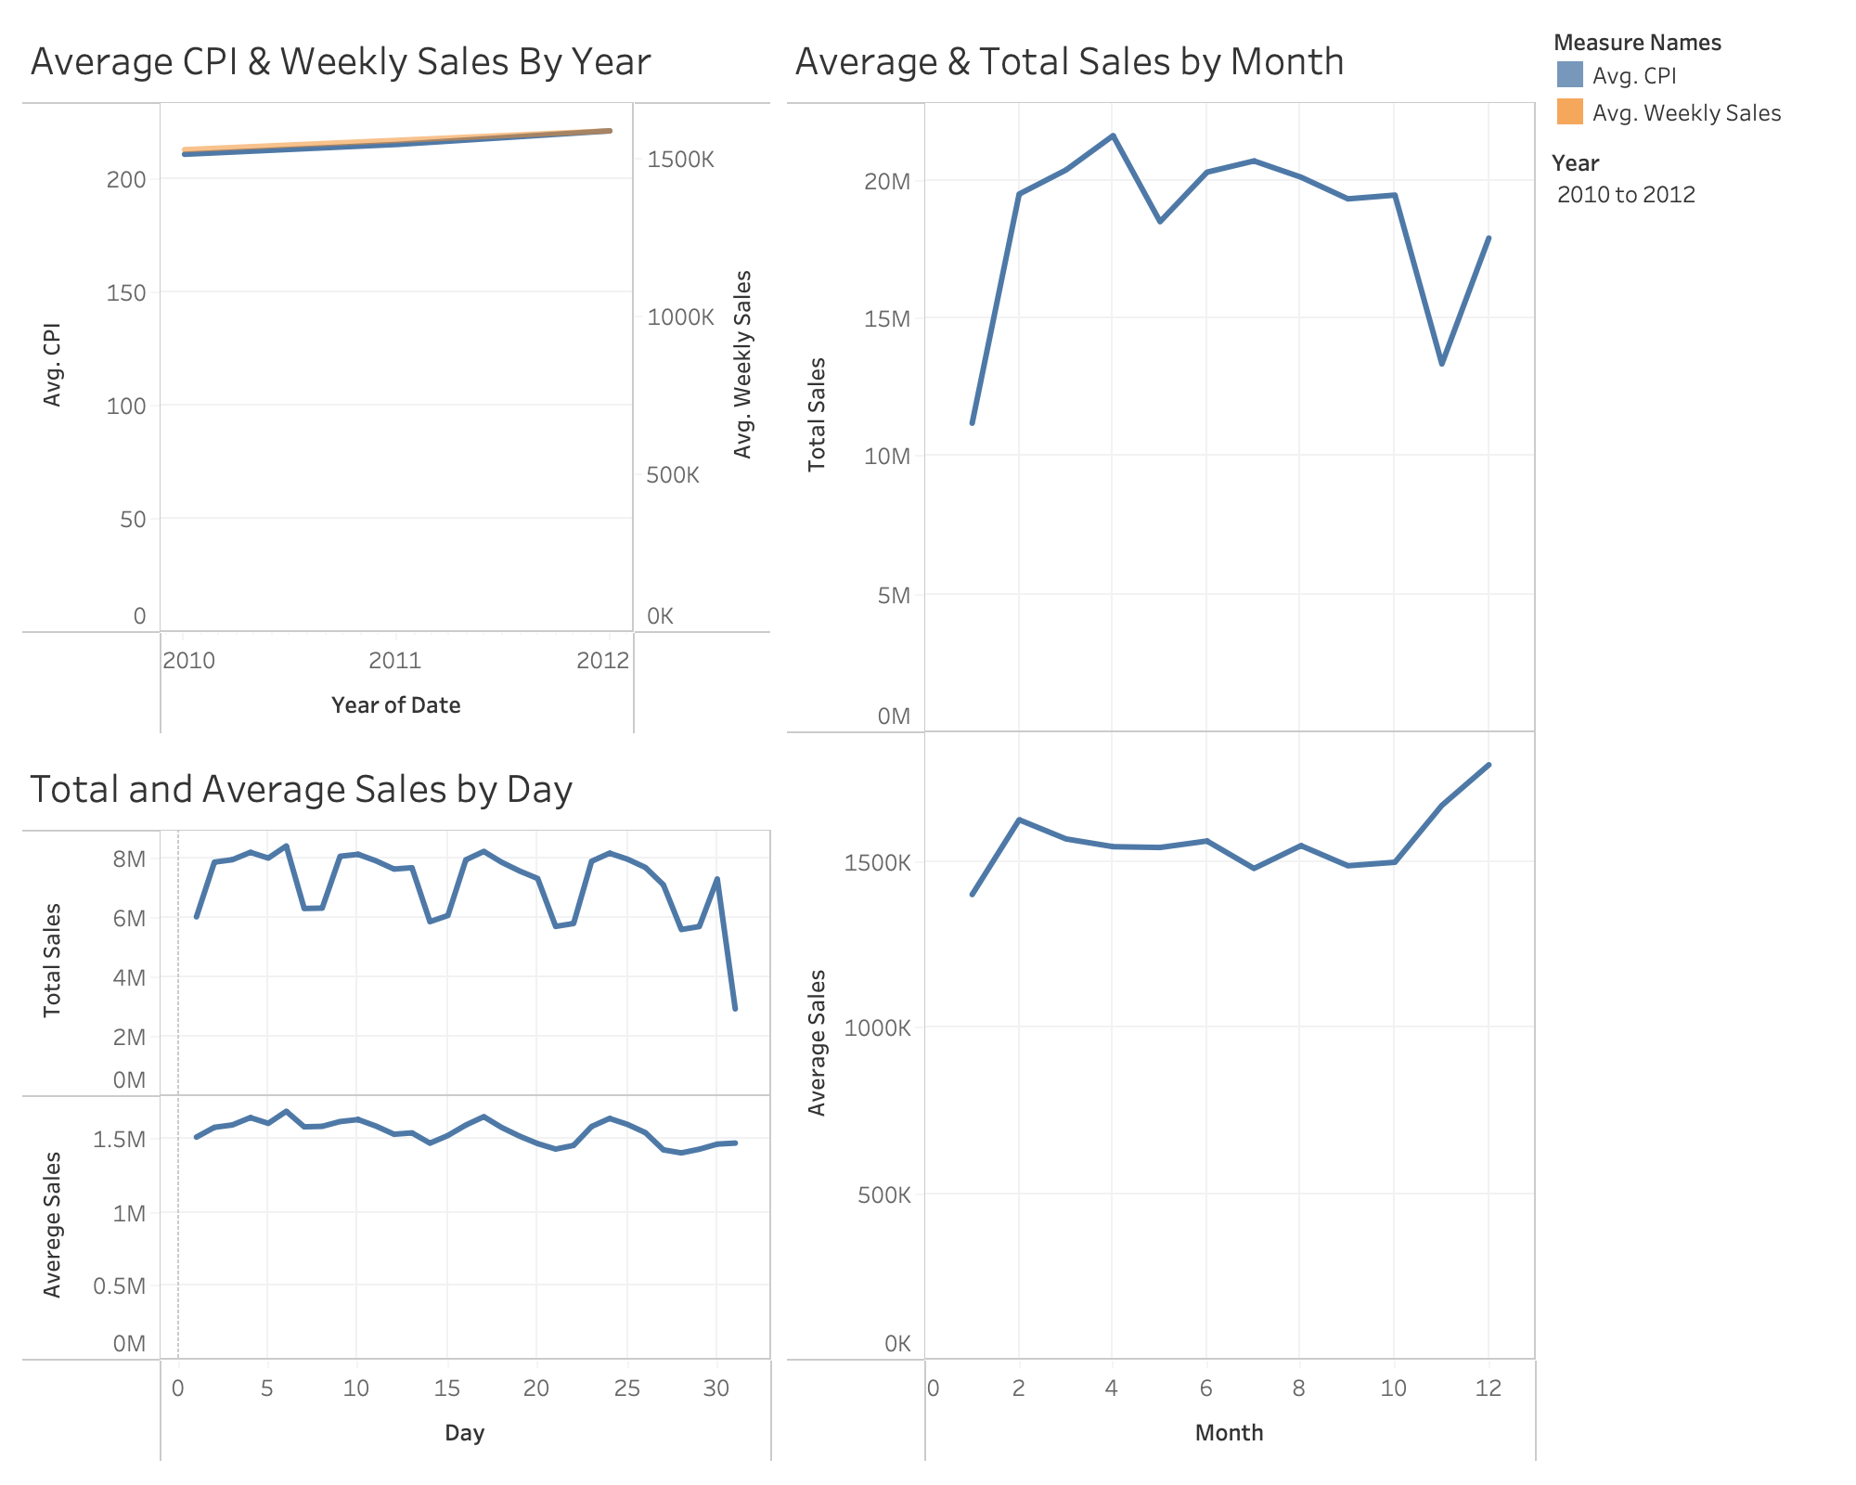
Tableau Dashboard
This dashboard segments total and average weekly sales across days and months, and shows the average CPI relative to average weekly sales to identify if there is a relationship between the two variables.
We applied filters the 3 different years (2010, 2011, and 2012) for the line graphs, depicting total weekly sales by day and month.

Slide 15
07
Conclusions

Slide 16
Conclusion #1
Weekly sales for Thanksgiving (last week of November) and Christmas weeks (last week of December) are above the upper control limit, due to increased gift-giving and purchases during the holiday season.
Conclusion #2
Average weekly sales shows that there is a spike in sales between October and December, most likely due to the holiday seasons. However, this is not reflected in the total weekly sales because timing of consumer purchases may vary.
Conclusion #3
Average sales follow a bi-weekly pay schedule as evidenced by the increases and decreases in weekly sales around Day 14 and 28 respectively.
Conclusion #4
Total weekly sales never dipped below the lower specification limit indicating this Walmart store never having a “bad” week over the 3 years of data.
Conclusion #5
The weekly sales for 2011 and 2012 after the year-high figure in the last week of December dips significantly the following week, which is the first week of January, most likely because shoppers are trying to save.
Conclusion #6
Total sales by day exhibits a cyclical or periodic trend as there are 4 evenly distributed troughs over 30 days, on day 7, 14, 21, and 28 respectively. This exemplifies that sales are down on the ends of weeks, usually when people will get paid the next day.

